Slide 1
RISCV CV32E40P CORE VERIFICATION USING UVM & SVA
Team 1
Abdelrahman Yassin Ahmed Khaled Ahmed Ibrahem Esmail Adbelrahman
Mohamed Mohsen
Ziad Ahmed

Slide 2

Content
RISC-V RV32IM Core Verification
Motivation to RV32IM
Design Block Diagram
UVM Testbench Architecture
Configurations
Key components and hierarchy
Important configuration object
Environment & Its components
Agents & their types
Coverage Collector
Scoreboard & Checkers
Simulation Results
Error Report
Coverage Closure
Scripts & Makefiles
This is the main part.

Slide 3
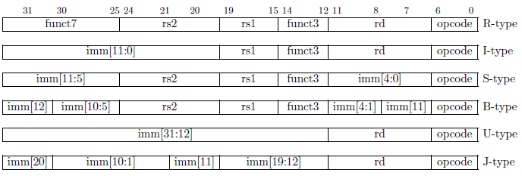
Motivation to RV32IM
RISC-V is a new instruction-set architecture (ISA) that was originally designed to support computer architecture research and education, but also become a standard free and open architecture for industry implementations.
In the base RV32I ISA, there are four core instruction formats (R/I/S/U). All are a fixed 32 bits in length and must be aligned on a four-byte boundary in memory. There are a further two variants of the instruction formats (B/J) based on the handling of immediates.
RISC-V 32IM Subsets:RV32I (Base Integer): Includes basic arithmetic, logical, load/store, control-flow, and CSR instructions.RV32M (Integer Multiplication/Division Extension): Adds multiply, divide, and remainder operations (e.g., MUL, DIV, REM).

Slide 4
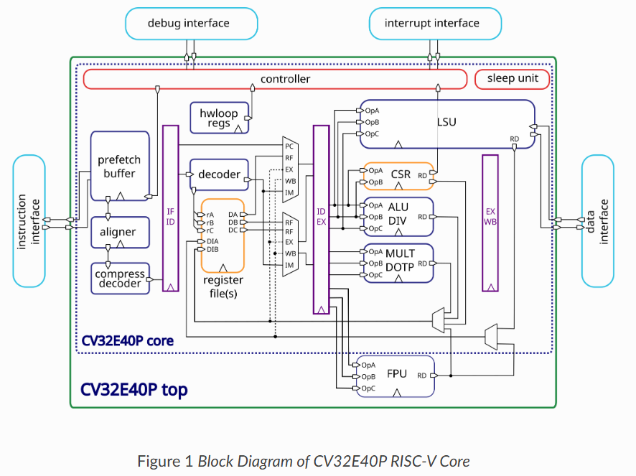
Design Diagram

Slide 5
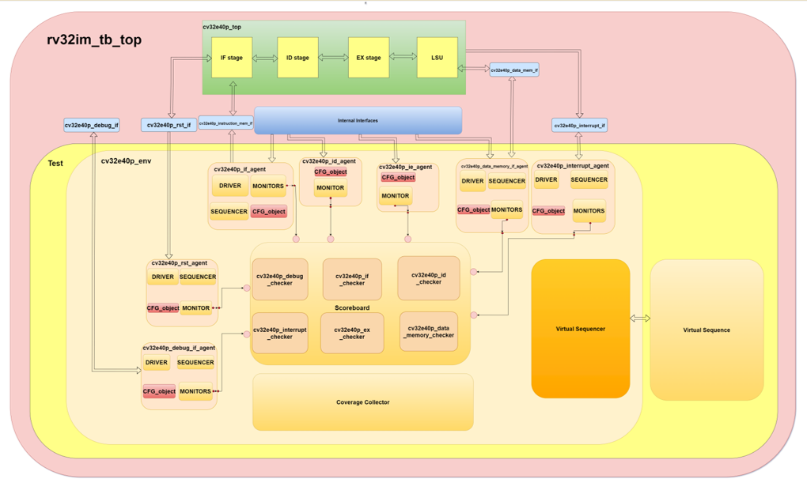
UVM Testbench Architecture

Slide 6


Configurations

Slide 7
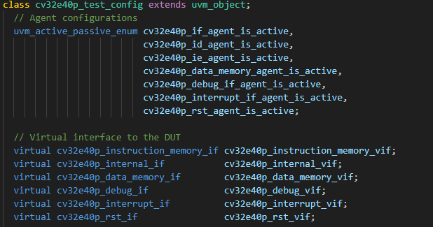
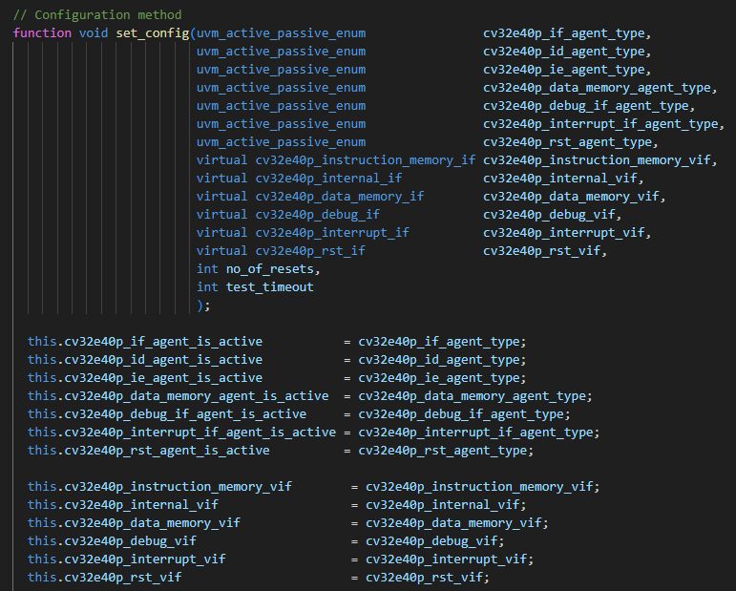
Config Objects
A Configuration object is passed to the test, then to the environment then the environment passes each agent its own config object
test_config
env_config
Data_memory agent
ie_agent
if_agent
id_agent
Debug_agent
Interrupt_agent

Slide 8
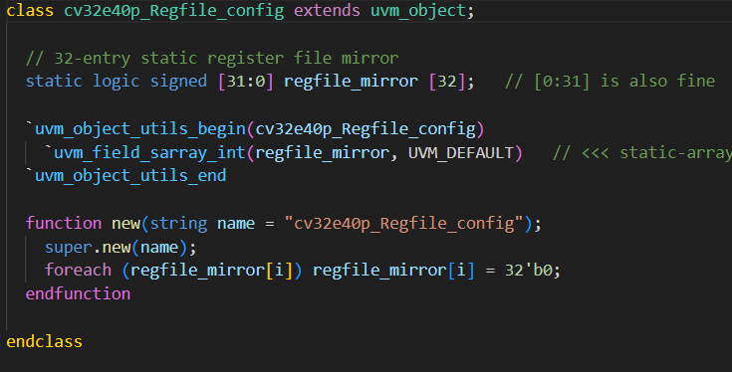

RegFile Verification Component
Used to have a RegFile mirror which is accessible by multiple components but only one component gets to write in it, To assert the data coherency between different components
ID Checker (Write/Read)
Accessed by
LSU Checker (Read only)

Slide 9

Sequence Items

Slide 10

Sequence Items
Identifies the common things between all of its children sequence items
Has all the instruction stage input & output signals (Black-Box & White Box Outputs)
Base_seq item
IF_seq item
Can be overridden with its children
Defines Constraints to generate correct instructions upon randomization
Has the signals which we’re concerned with from the Decode stage input & output signals (Internal)
Has the signals which we’re concerned with from the Execute stage input & output signals (Internal)
ID_seq item
EX_seq item
Registered said signals using obj utilities for comparison, copying, cloning…etc
Registered said signals using obj utilities for comparison, copying, cloning…etc

Slide 11
Sequence Items
Identifies the common things between all of its children sequence items
Has all the Data_Memory Interface input & output signals
Base_seq item
Data_Mem_seq item
Can be overridden with its children
Defines Constraints to generate correct instructions upon randomization
Has all the Debug Interface input & output signals
Has all the Interrupt Interface input & output signals
debug_seq item
interrupt_seq item
Registered said signals using obj utilities for comparison, copying, cloning…etc
Registered said signals using obj utilities for comparison, copying, cloning…etc

Slide 12
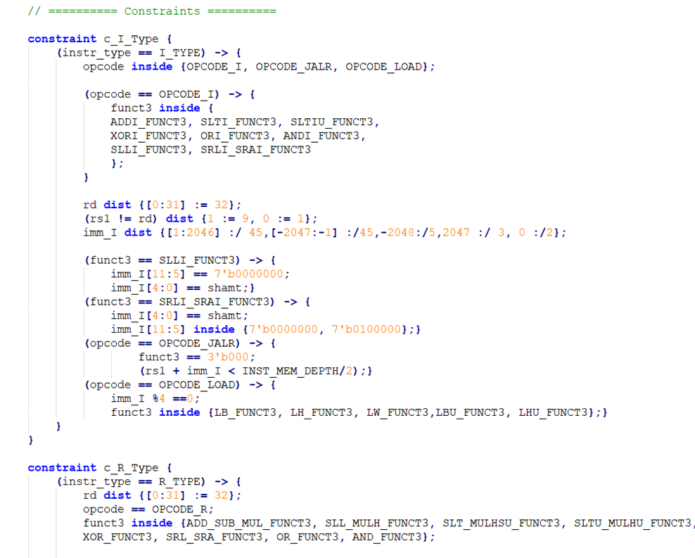
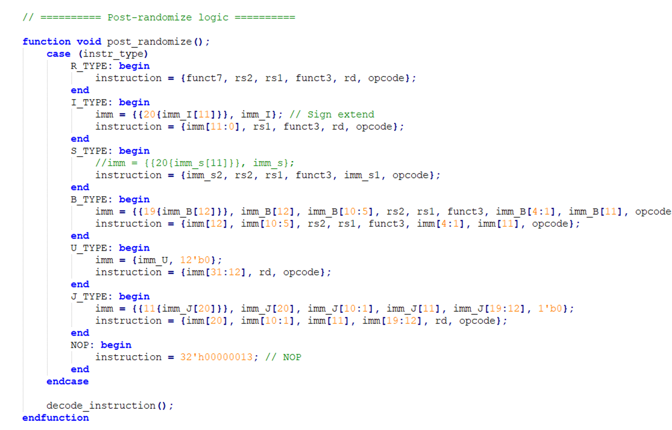
Sequence Items

Slide 13

Interfaces

Slide 14
Interfaces
Identifies & connects all the input signals to the Instruction Fetch Interface
Identifies & connects all the needed intermediate core signals of the IF, ID, IE, WB stages to the their respective agents
Instruction Fetch Interface
Internal Interface
Is handed to the observer module to connect it to the Core’s internal signals
Defines A number of Assertions
Interrupt Interface
Identifies & connects all the input signals to the Instruction Interrupt Interface
Has all the Debug Interface input & output signals
Debug Interface
Identifies & connects all the input signals to the Instruction debug Interface
Data Memory Interface
Defines a number of Assertions

Slide 15

Environment

Slide 16
Environment
1
2
3
4
Instantiate
Create
Connect
Initialize
Instantiates all environment components & TLMs
Creates all the instances handles
Connects all TLM ports, exports & implementations
Initializes all agents using their respective configs

Slide 17

AGENTS

Slide 18
Agent Types
Active
Agent Types
Reactive
Passive

Slide 19
Three Types of Reactivity
Using UVM Feedback Implicit Mechanism
Reactivity
Using an asynchronous or synchronous monitor with TLM to sequencer/sequence
@(vif.cb_mon.x); in the driver class

Slide 20
Reactive Agent
Reset Agent
Gets Configuration from Environment
Active Agent
Instantiates:
Monitor
Driver
Sequencer
Creates & Connects to the entire environment

Slide 21
Reactive Agent
Instruction Fetch
Data Memory Slave
Debug Mode
Interrupt Mode
Gets Configuration from Environment
RE-
Active Agent
Instantiates:
Monitor
Driver
Sequencer
Creates & Connects

Slide 22
Passive Agent
Instruction Fetch (IF)
Instruction Decode (ID)
Instruction Execution (EX)
Gets Configuration from Environment
Passive
Agent
Instantiates:
Monitor
Creates & Connects

Slide 23
if_agent(Reactive)
Driver at 0 time gets all instructions from running sequences.
Driver has internal memory to store all instruction (acts as instruction memory driver)
instr_gnt_i is always 1
Driver has 2 main tasks :
1. get_instructions : to fill its memory and then trigger fetch_enable_i for 1 clk to start fetching
2. sample_requests_and_drive: it has 2 subtasks:
sample_and_send : if a instr_req occurs it samples the address required &
send the mapped instruction in memory to mailbox
send_response: get the response from mailbox and sends it on instr_rdata_i
bus after some random ldelay (valid_delay)
Driver can send B2B & multiple outstanding transactions (based on delay)

Slide 24
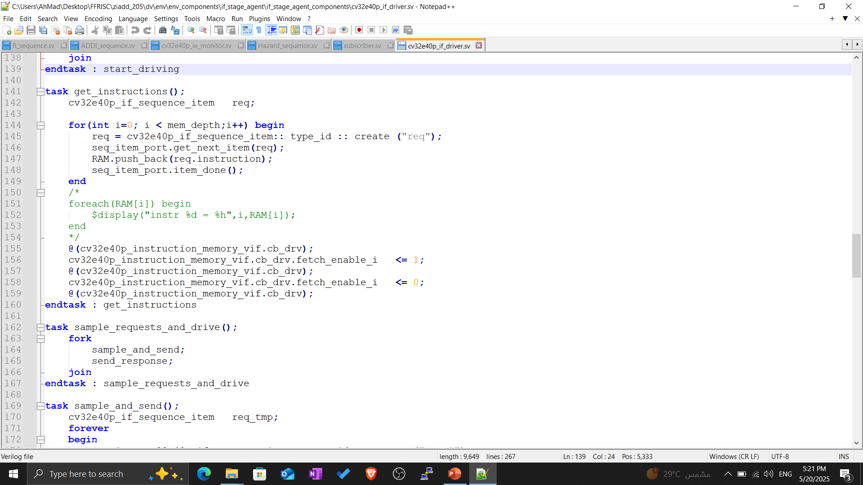
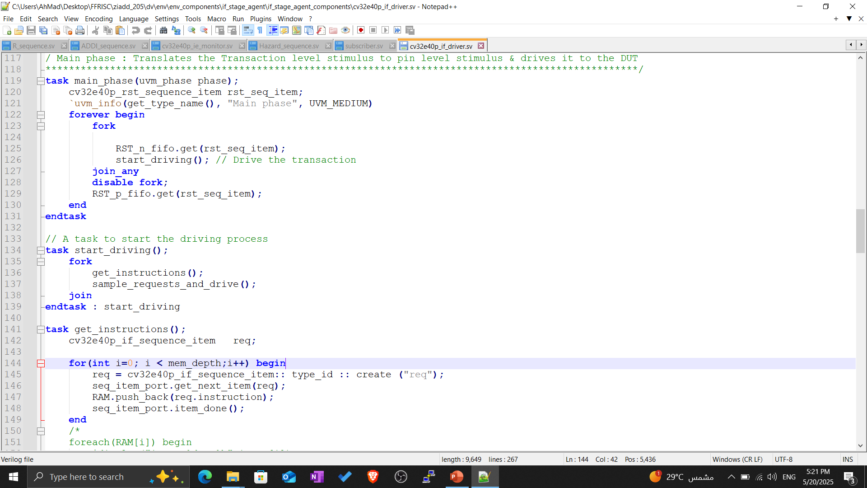
if_agent(Reactive)

Slide 25
data_memory_if_agent (slave)
Driver consist of 3 parallel taks:
sample_and_send: responsible to sample any data_req_o & get the response from sequence & push it to mailbox
send_response: takes responses & drive on DUT based on random value valid_delay
grant_task:randomizes data_gnt_i to test different scenarios
Can send B2b ,multiple outstanding transactions

Slide 26
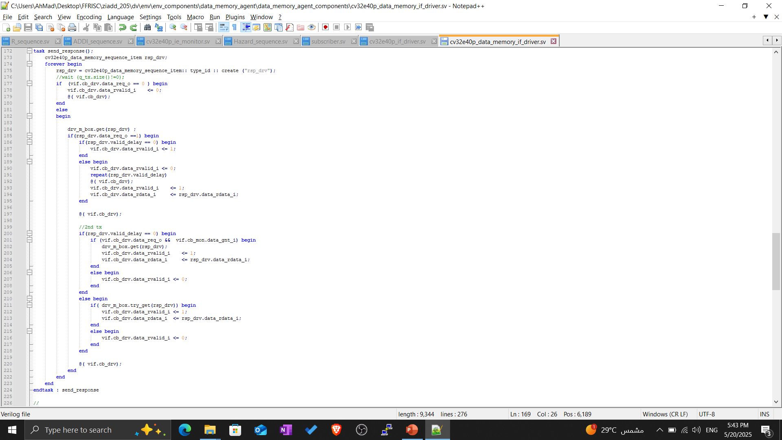
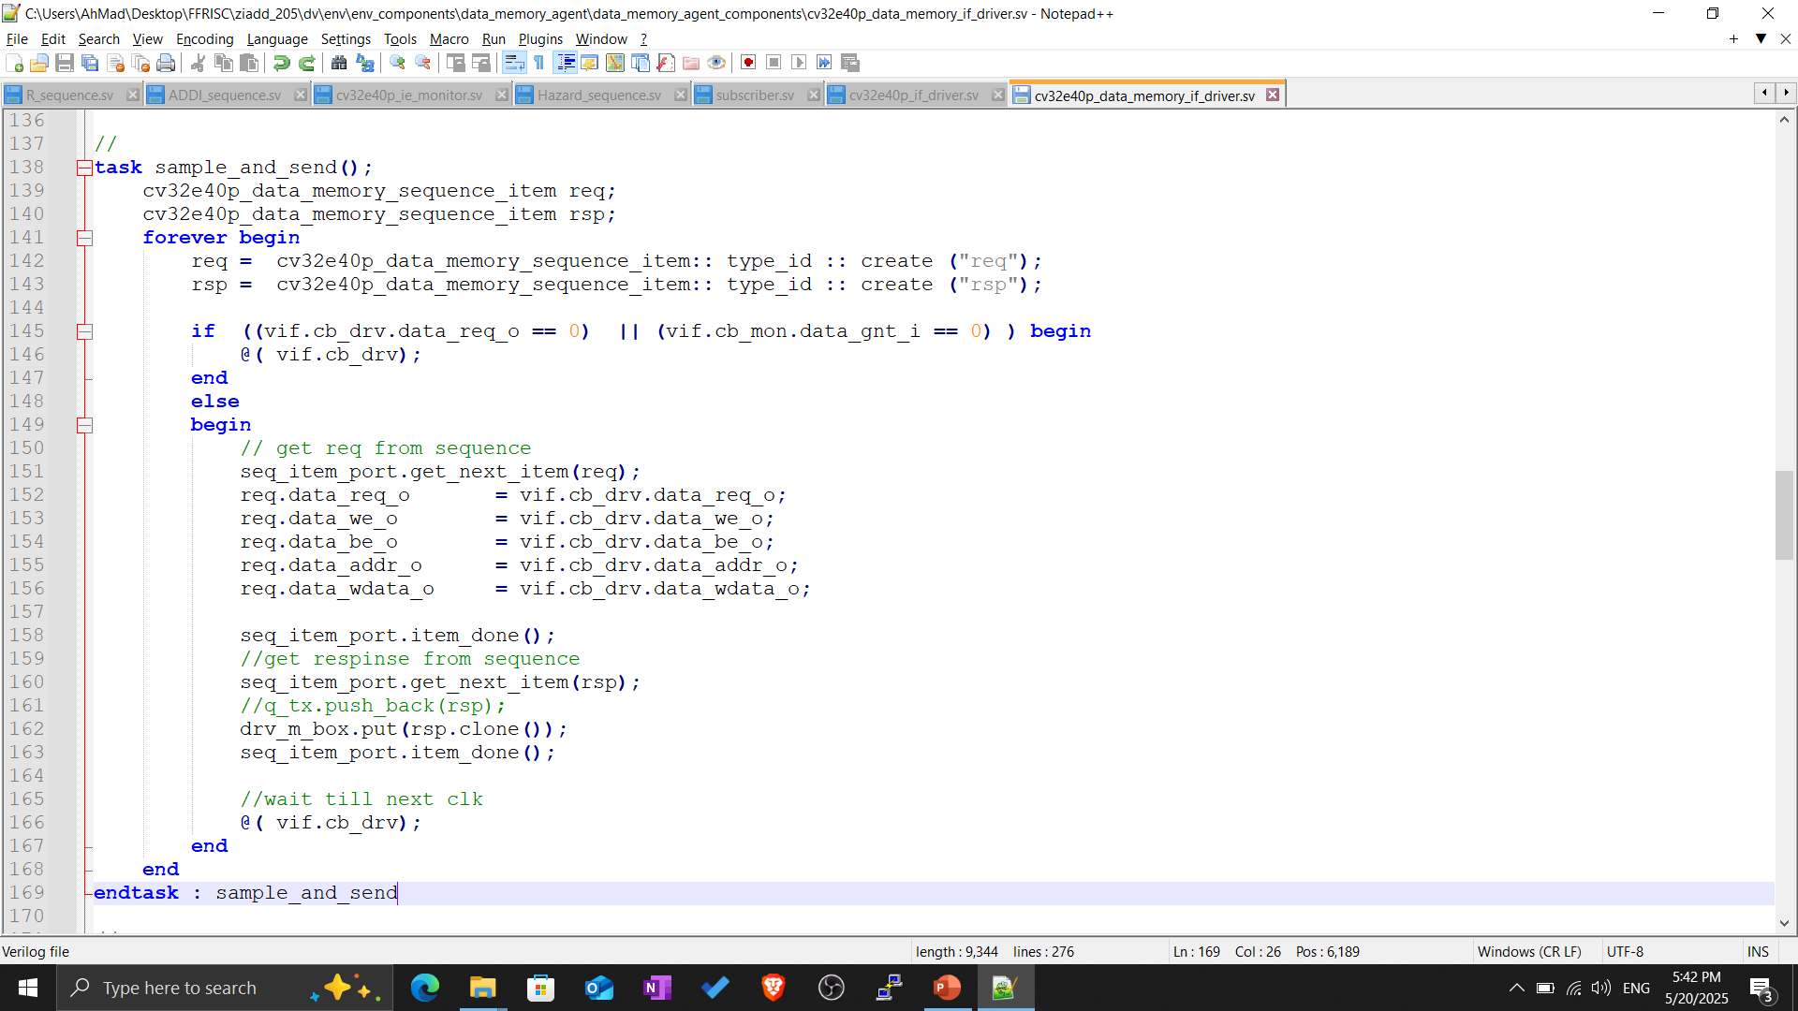
data_memory_if_agent (slave)

Slide 27
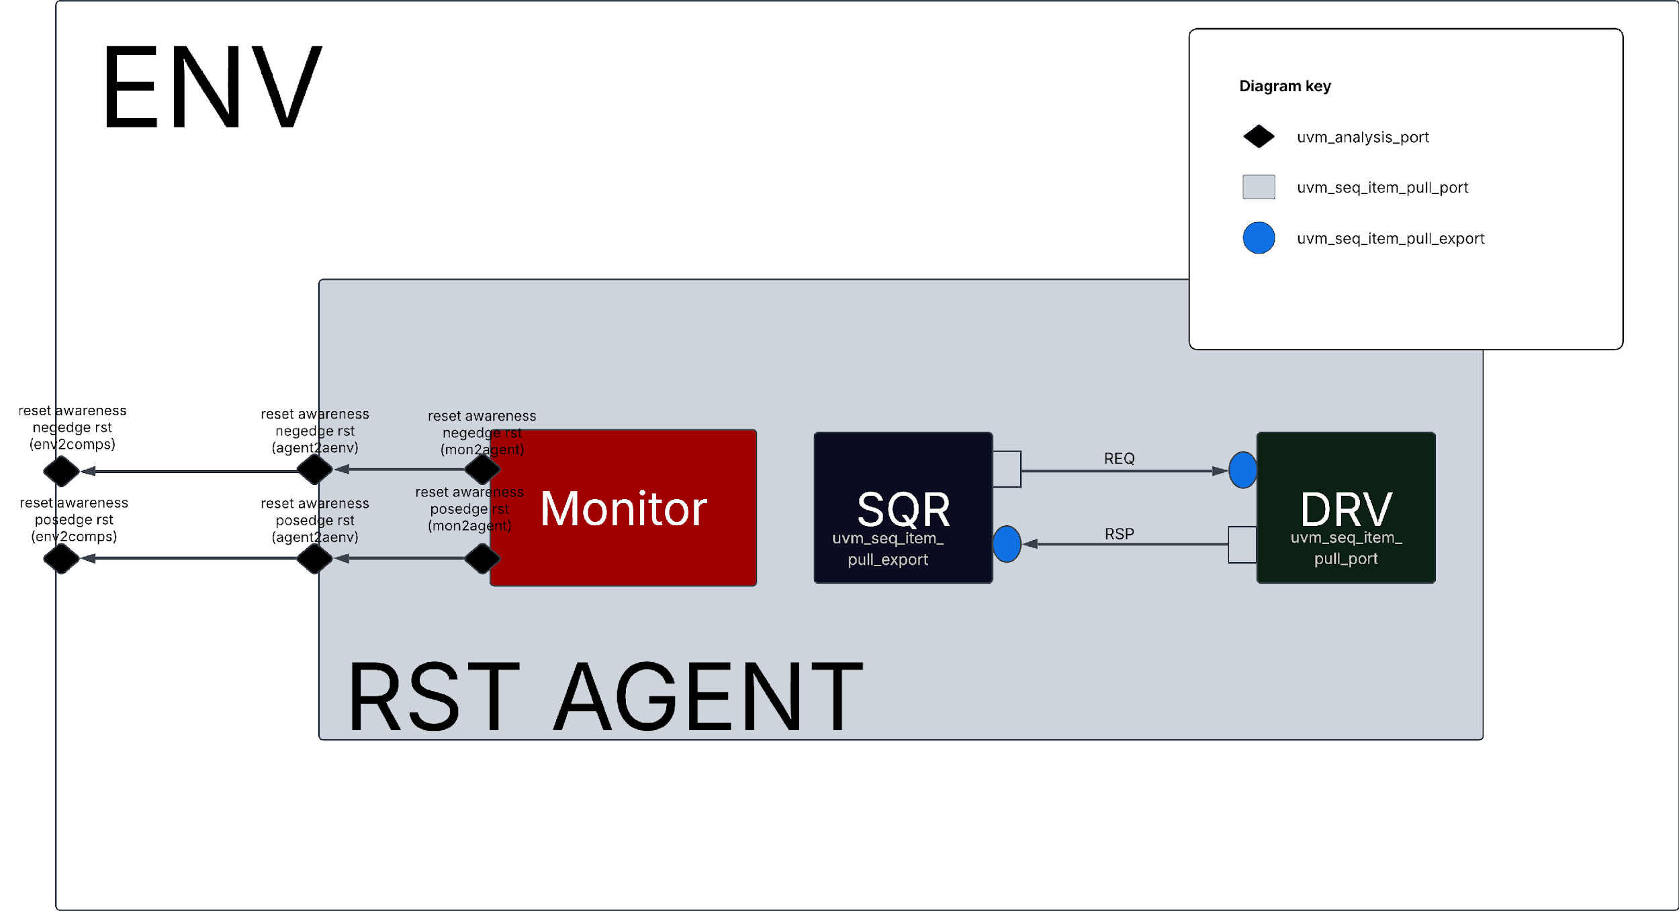
RST AGENT TLM DIAGRAM
The reset awareness was inspired from The published paper Handling Asynchronous Reset(s) Testing by building reset-awareness into UVM testbench components by Wei Wei Cheong, Katherine Garden, Ana Sanz Carretero which was previewed @DVCON 2021
As shown in the figure, the rst agent monitor class is always waiting for reset assertion, and as soon as it is asserted, the monitor class writes to the uvm_tlm_analysis_port so it reaches every reset_aware component and hence allows them to act accordingly.

Slide 28
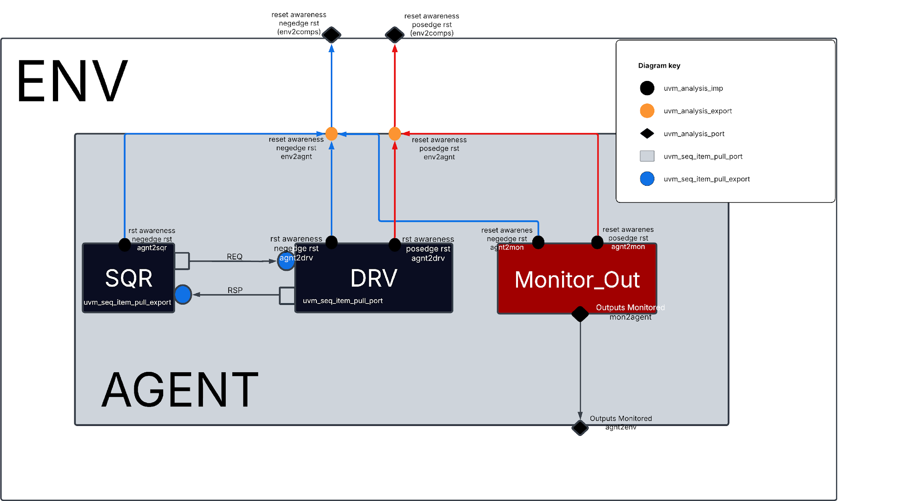
AGENT TLM DIAGRAM
The reset awareness was inspired from The published paper Handling Asynchronous Reset(s) Testing by building reset-awareness into UVM testbench components by Wei Wei Cheong, Katherine Garden, Ana Sanz Carretero which was previewed @DVCON 2021
As shown in the figure, the agent is fully reset aware, every component is connected with uvm_tlm_analysis_imp s to allow it to react to asynchronous reset assertion.
Note: the sequencer in this agent the stop_sequences() function is called within the write function body defined @it, therefore stopping all sequences and calling item_done to all the current running items by the driver.

Slide 29

Virtual Sequencer

Slide 30
Virtual Sequencer
Virtual Sequencer
Instantiates the active agent_sequencer & the rst_sequencer so they can be used later to point to the sequencers of the same type inside the virtual sequence and start sequences respectively on them

Slide 31

TESTS & VIRTUAL SEQUENCES

Slide 32
Base-Test
Inestantiates the Virtual Sequence
Gets the test_config and uses it to initialize the environment then set the env_cfg to the env
Base-Test
Sets timeout value to the base_vseq to prevent hanging
Starts the base_v_seq on the virtual sequencer

Slide 33
Tests
Overrides bas_vseq with R_type_std_vseq
Overrides bas_vseq with I_type_std_vseq
R_type_std_test
I_type_std_test
Checks standard R-type register-to-register instructions like add, sub, and, or, xor, etc.
Checks standard I-type instructions like addi, subi, andi, or, xori, etc.
Overrides bas_vseq with I_type_store_load_vseq
Overrides bas_vseq with I_type_load_vseq
I_type_store_load_test
I_type_load_test
Checks store & load I-type instructions like sb, sh, sw, lb, lh,lw, etc.
Checks load I-type instructions like lw, lh, lb, lhu, lbu, etc.

Slide 34
Tests
Overrides base_vseq with Hazard_vseq
Overrides base_vseq with M_Extension_vseq
Hazard_test
M_Extension_test
Checks standard Hazard instructions like read after write, writing != 0 to x0.. etc.
Checks standard R-type register-to-register instructions like div, divu, mulhsu, or, rem, etc.
Overrides base_vseq with S_type_std_vseq
Overrides base_vseq with jalr vseq Overrides base_vseq with U_type_vseq
S_type_std_test
Jalr_test
&
U_type_test
Checks standard S-type instructions like sb, sh, and, sw.
Checks standard I-type instruction: jalr
Checks standard U-type instructions like lui, auipc.

Slide 35
Base-vseq
Inestantiates handles of all the sequences
Inestantiates handles of all the sequencers
Base-vseq
Uses `uvm_declare_p_sequencer to create set and casts the p_sequencer to the virtual sequencer which runs the virtual sequence
Hands configurations to sequences if needed

Slide 36
Virtual Sequences
Creates all R-Type STD sequences & starts them with the desired pattern
Creates all R-Type STD sequences & starts them with the desired pattern
R_type_std_vseq
I_type_std_vseq
Starts standard R-type register-to-register sequences like and stores seq_items add_seq, sub_seq, and, or_seq, xor_seq, etc.
Starts standard I-type sequences like and stores seq_items addi_seq, subi_seq, and, ori_seq, xori_seq, etc.
Creates all R-Type STD sequences & starts them with the desired pattern
Creates all R-Type STD sequences & starts them with the desired pattern
I_type_store_load_vseq
I_type_load_vseq
Starts standard R-type register-to-register sequences like and stores seq_items sb_seq, sh_seq, and, sw_seq, lb_seq,lh_seq, etc.
Starts standard R-type sequences like and stores seq_items lw_seq, lh_seq, and, lb_seq, lhu_seq, etc.

Slide 37
Virtual Sequences
Creates all Hazard sequences & starts them with the desired pattern
Creates all M_Extension R-Type sequences & starts them with the desired pattern
Hazard_vseq
M_Extension_vseq
Starts standard Hazard sequences like addi != 0 value to rd, read after write.., etc.
Starts standard R-type register-to-register sequence and stores seq_items like div_seq, divu_seq, and, mulhsu_seq, rem_seq, etc.
Creates all S-Type sequences & starts them with the desired pattern
Creates jalr I-Type sequence & starts it with the desired pattern
Creates all U-Type sequences & starts them with the desired pattern
S_type_std_vseq
Jalr_test
&
U_type_vseq
Starts standard S-type sequences like and stores seq_items sb_seq, sh_seq, sw_seq etc.
Starts jalr I-type sequence like and stores seq_items like jalr_seq, etc
Starts standard U-type sequences like and stores seq_items like lui_seq, aui_seq, etc.

Slide 38

SUBSCRIBER

Slide 39
Subscriber
Each Subscriber has is connected to the following Agents:
Instruction Interface
Debug Interface
Interrupt Interface
Data Memory Interface
Instruction Fetch Agent
Instruction Decode Agent
Instruction Execution
Receives input stimulus & outputs monitored by the monitor using fork_joined .get() if needed, but only currently uses the ID stage inputs to make sure that the operation has been decoded and is going to be executed
Subscriber
Can be parameterized with test_name, has instance based coverage & static coverage
Is reset aware therefore it is disabled when a reset assertion happens.

Slide 40
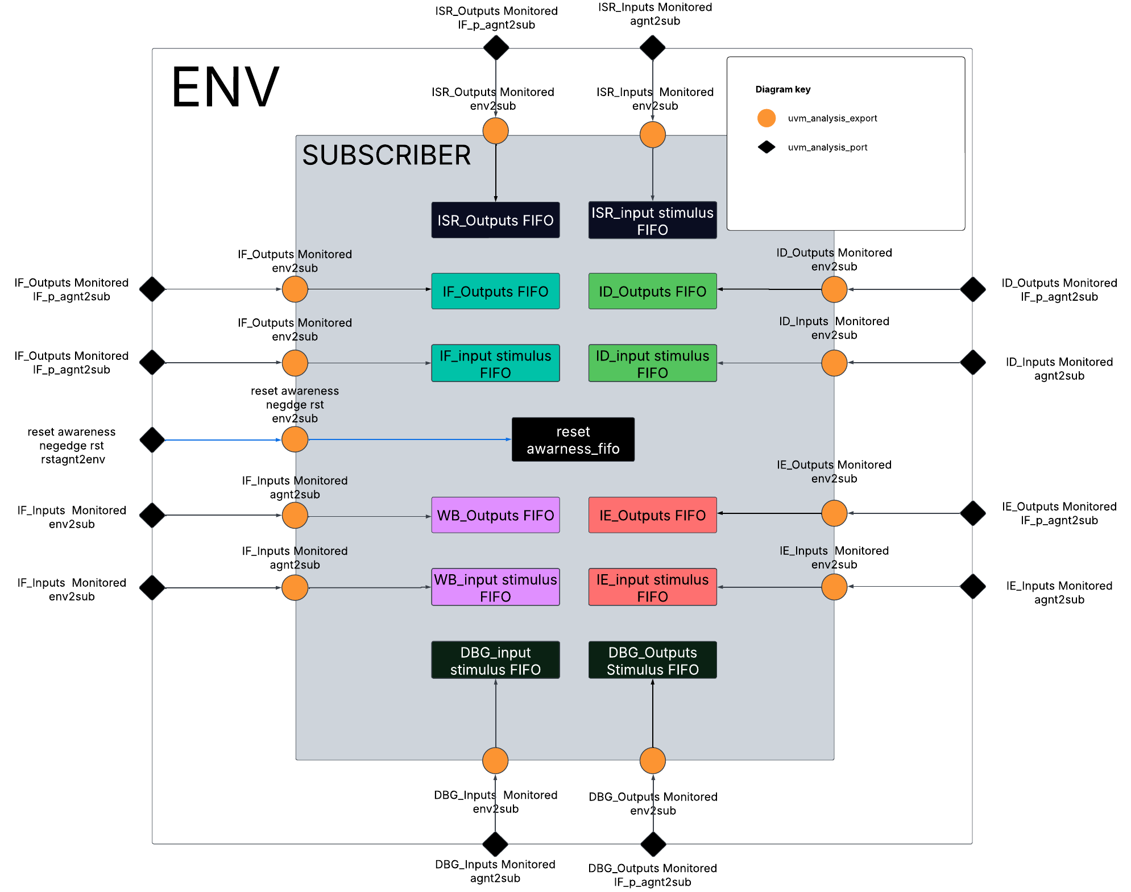
SUBSCRIBER TLM DIAGRAM
The reset awareness was inspired from The published paper The reset awareness was inspired from The published paper Handling Asynchronous Reset(s) Testing by building reset-awareness into UVM testbench components by Wei Wei Cheong, Katherine Garden, Ana Sanz Carretero which was previewed @DVCON 2021

Slide 41

SCOREBOARD

Slide 42
Checkers
Instruction Fetch
Checker (OBI)
Checks the OBI protocol assertion in the Instruction Fetch Interface
EX Checker
Checks the outputs of the Execution stage against the expected outputs which are predicted using the EX stage inputs
ID & Regfile Checker
Checks the Decoding against the outputs of the decoding stage & Regfile against wb signals
Debug intf
checker
Checks the validity of the outputs from the debug interface
LSU Checker
Checks the outputs of the LSU stage against the expected outputs from the decode stage

Slide 43
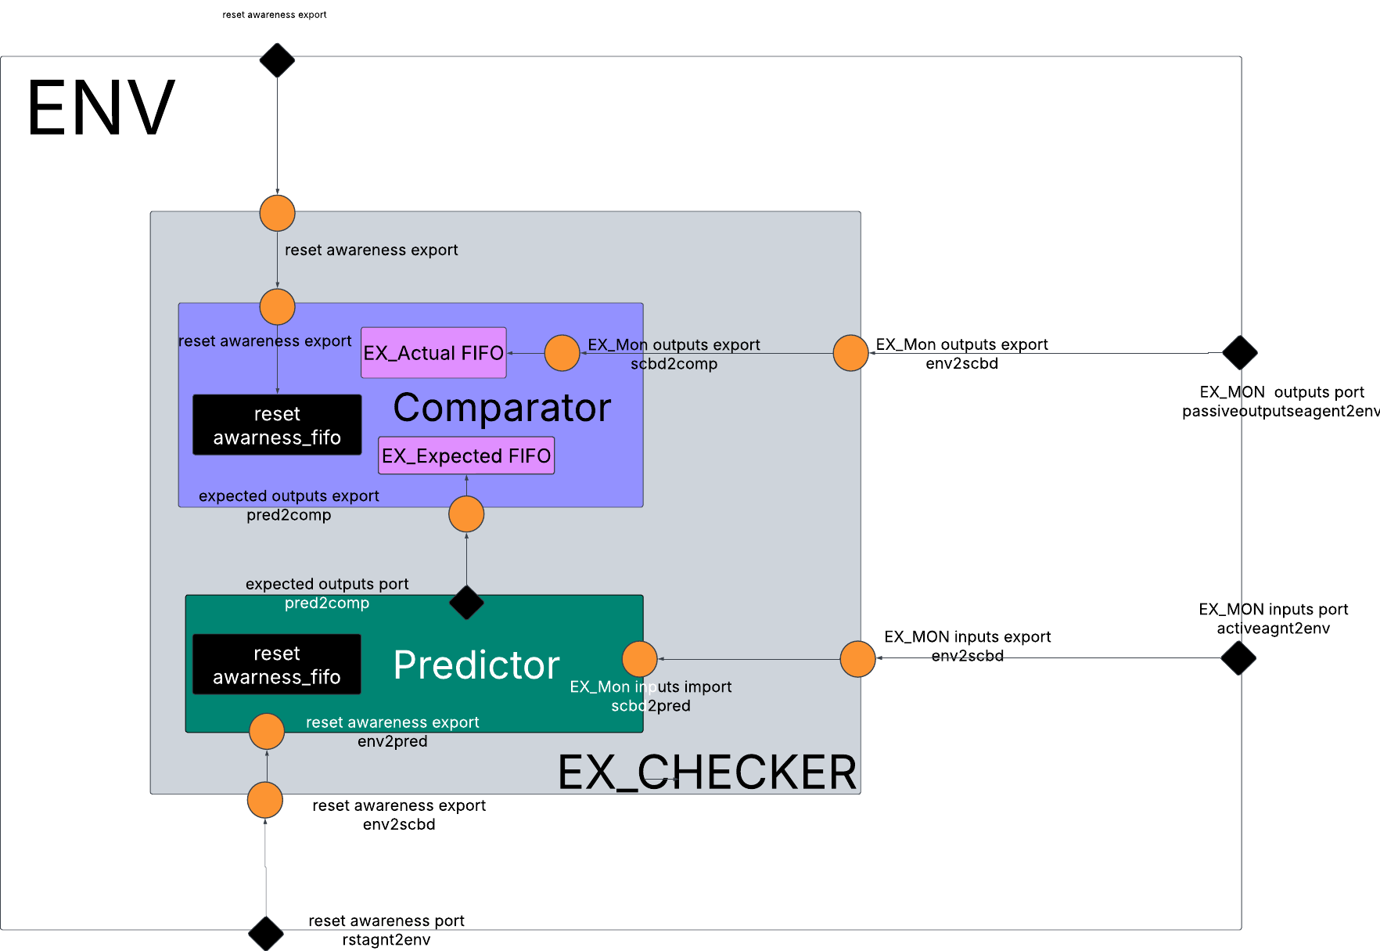
CHECKER EXAMPLE TLM DIAGRAM
The hierarchy of this scoreboard is inspired from Clifford Cumming’s OVM-UVM Scoreboards-Fundamental Architectures The reset awareness was inspired from The published paper Handling Asynchronous Reset(s) Testing by building reset-awareness into UVM testbench components by Wei Wei Cheong, Katherine Garden, Ana Sanz Carretero which was previewed @DVCON 2021

Slide 44
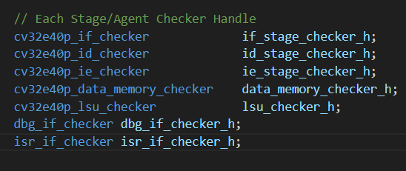
Checker
Each Active Agent has a Scoreboard:
IF Checker (OBI)
Data Memory Checker (OBI)
ID & Regfile Checker
EX Checker
LSU Checker
Debug Checker
Interrupt Interface
Connects the EXPORTS coming from the environment to the EXPORTS inside the COMPARATOR & the PREDICTOR
Connects the EXPORT Inside the Comparator to the PORT inside the predictor to get the PREDICTED ITEM and compare it to the ACTUAL SAMPLED ITEM
Checker
Halts the test using TEST TERMINATION TECHNIQUE used in Clifford Cummings’ OVM & UVM TECHNIQUES FOR TERMINATING TESTS. Raising the objection using the Phase_ready_to_end_phase
Keeps track of Incorrect & Correct comparisons during simulation and displays them in a report

Slide 45
Predictor
Each Scoreboard Agent has a Predictor for:
Instruction Interface
Debug Interface
Interrupt Interface
Data Memory Interface
Instruction Fetch Agent
Instruction Decode Agent
Instruction Execution
Gets the input stimulus sent by the input Monitor using the .get() blocking task from the tlm_analysis_fifo declared within it.
PREDICTOR
Predicts the Expected Result, assigns it to a seq_item and writes it to the tlm_analysis_port declared within it to the COMPARATOR
Is reset aware, disables all the operations as soon as a reset is detected through the reset TLM

Slide 46
COMPARATOR
Each Checker has a Comparator:
Instruction Interface
Debug Interface
Interrupt Interface
Data Memory Interface
Instruction Fetch Agent
Instruction Decode Agent
Instruction Execution
Gets the output that was sampled by the output monitor through the uvm_tlm_analysis_fifo using .get() blocking task
SCOREBOARD
Compares the sampled outputs to the expected seq_item sent by the predictor
Is reset aware, disables all the operations as soon as a reset is detected through the reset TLM

Slide 47
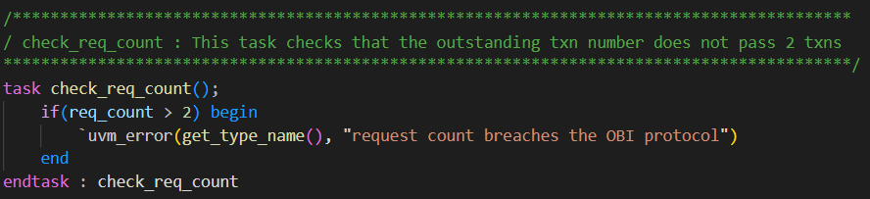
Instruction Fetch

Slide 48
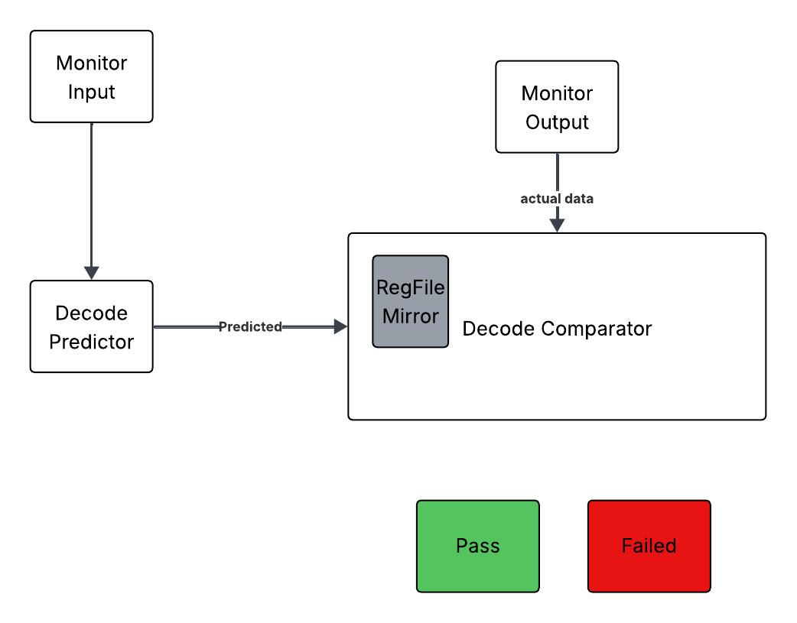
Instruction Decode

Slide 49

Waveforms & Simulation Results

Slide 50
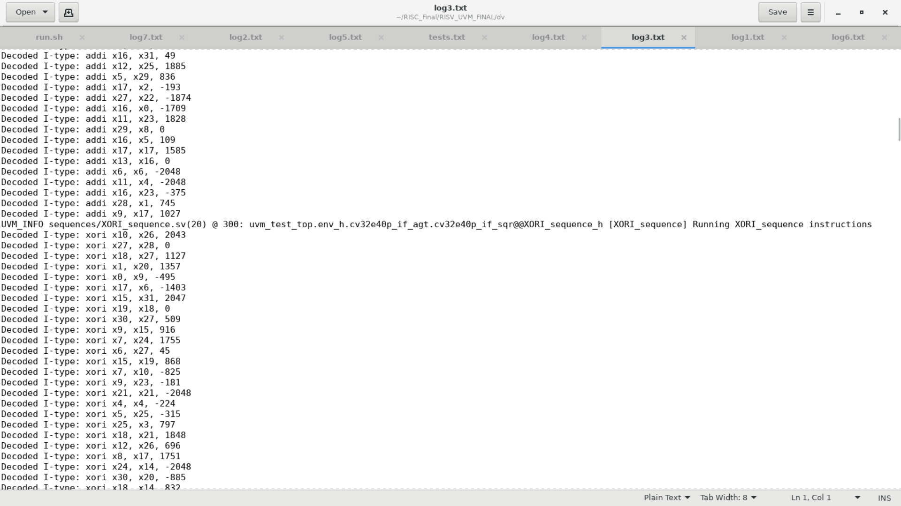
Simulation Results

Slide 51
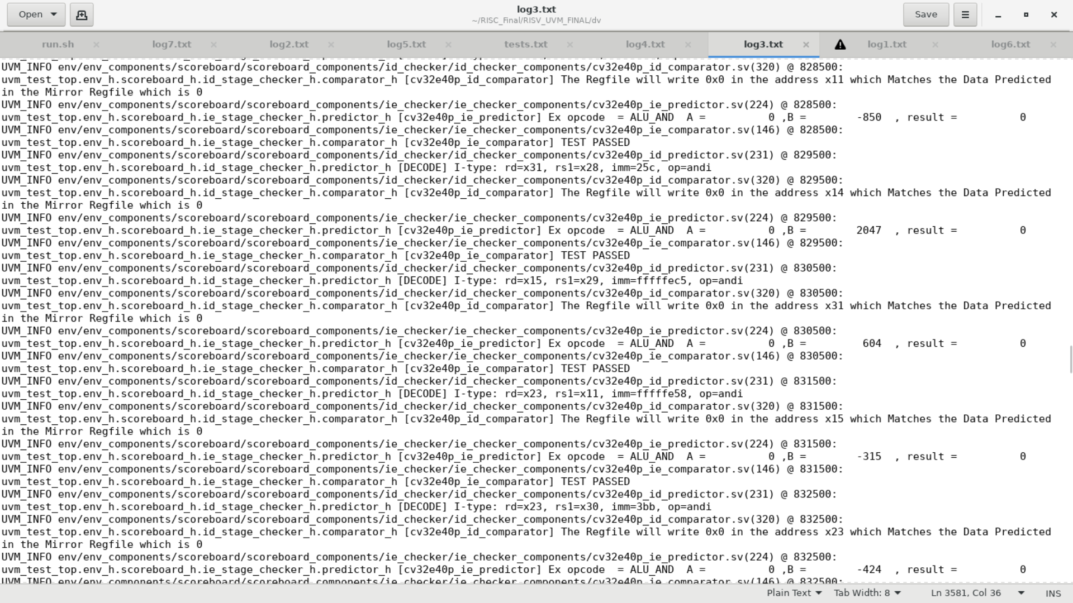
Simulation Results

Slide 52
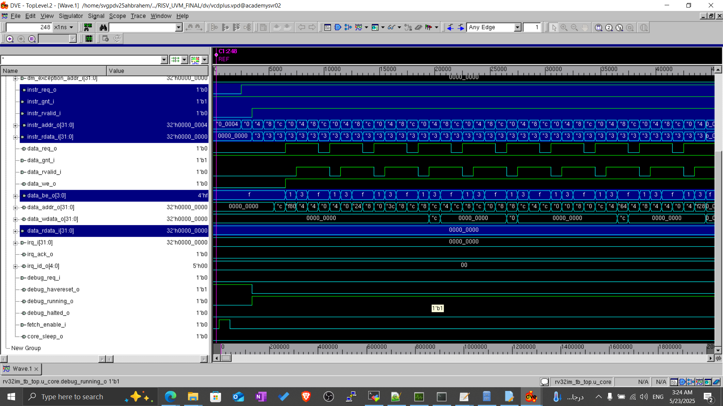
Simulation Results

Slide 53
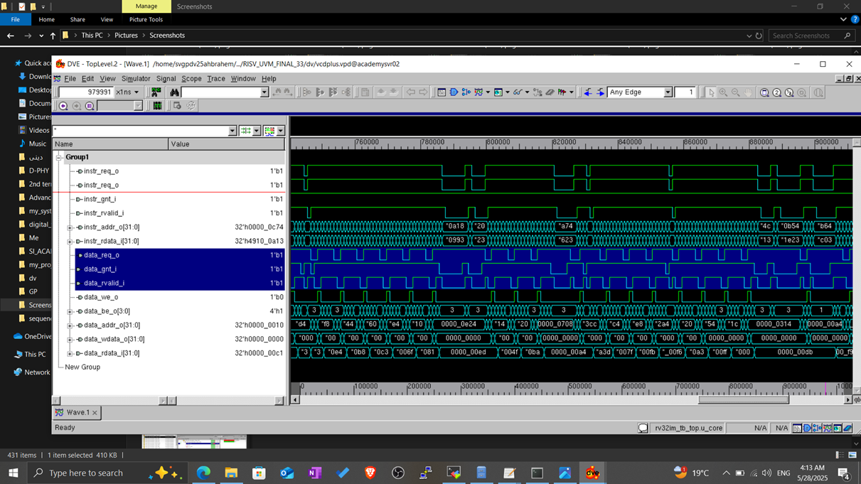

Slide 54

Coverage Closure

Slide 55
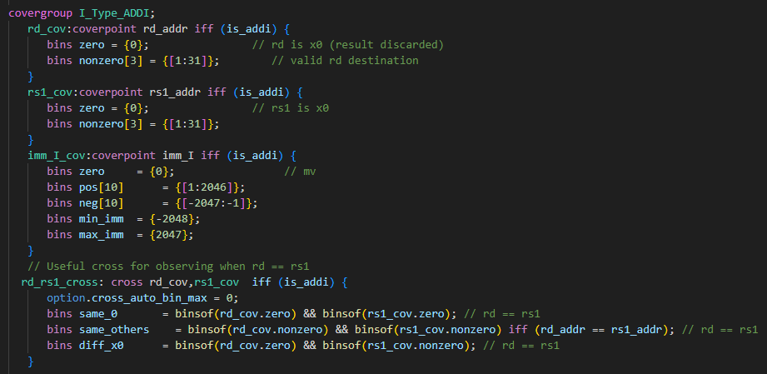
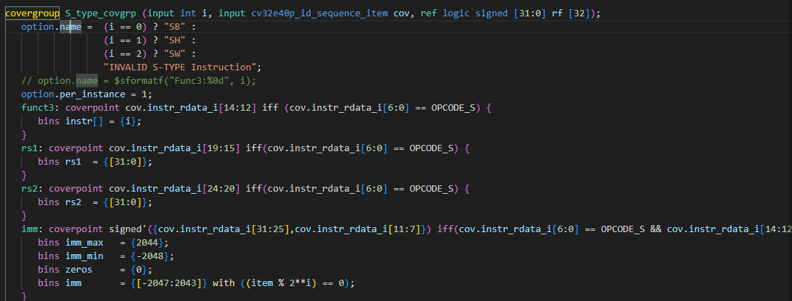

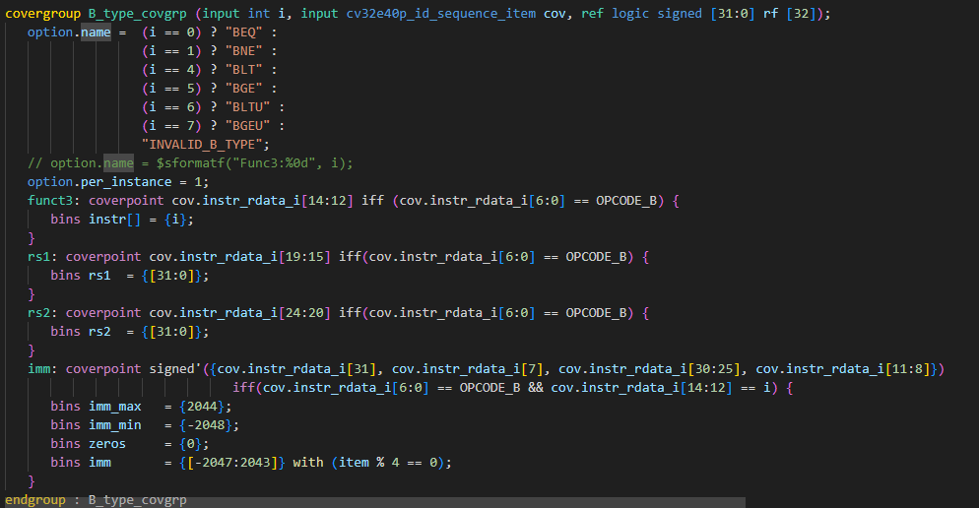
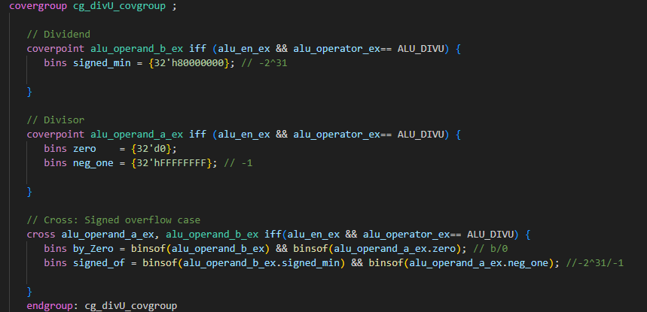
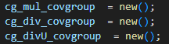
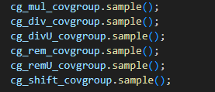
Coverage Examples
Fixed/Cross – based coverage
method
Instance – based coverage method
BODY
Construction
Sampling

Slide 56
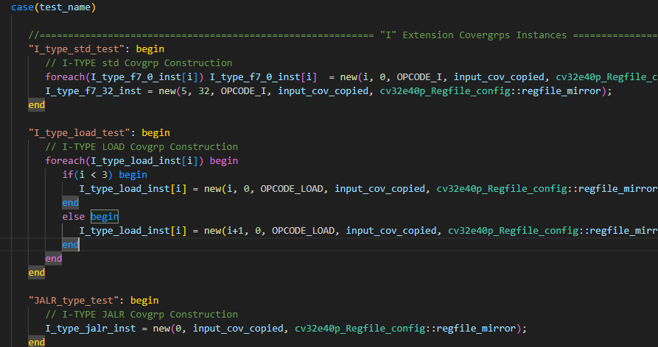
Coverage Closure
- Instance Parameterization according to test name

Slide 57
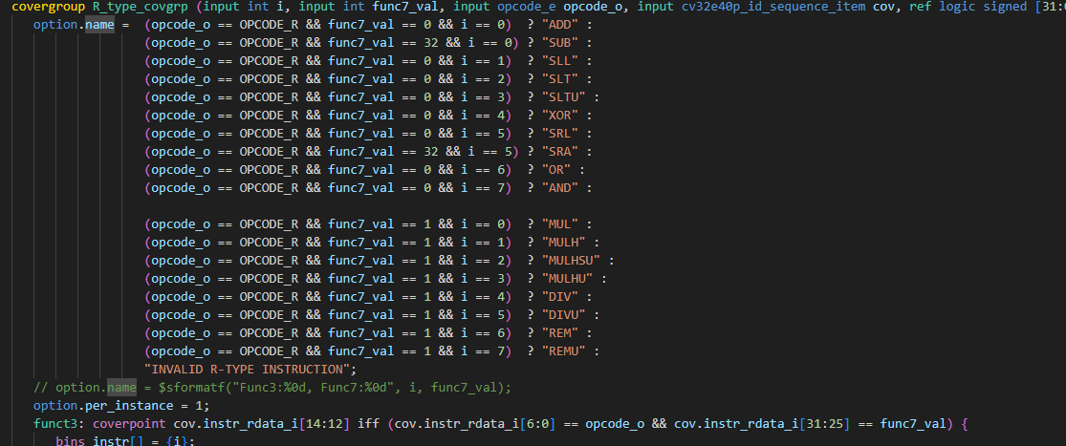
Coverage Closure
Naming & Segmentation Faults faced

Slide 58
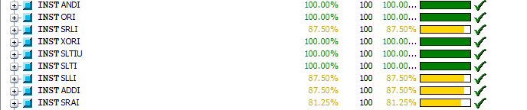
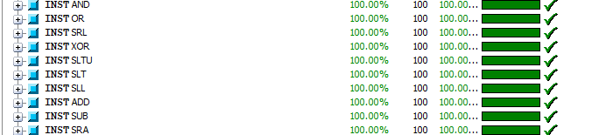
Coverage Closure

Slide 59
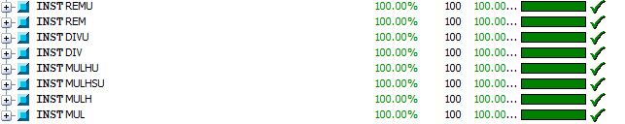
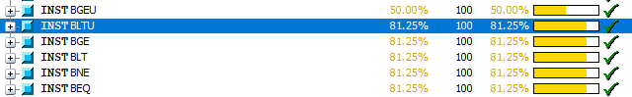
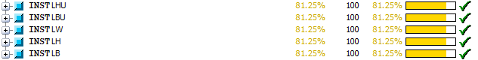
Coverage Closure

Slide 60
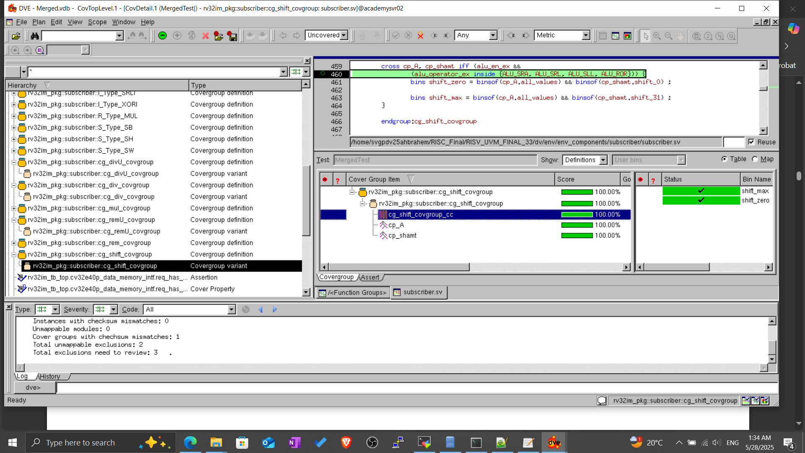
Coverage Closure

Slide 61
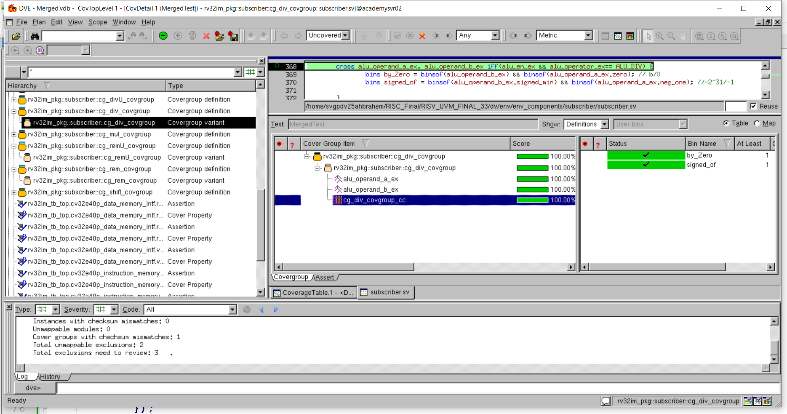
Coverage Closure

Slide 62
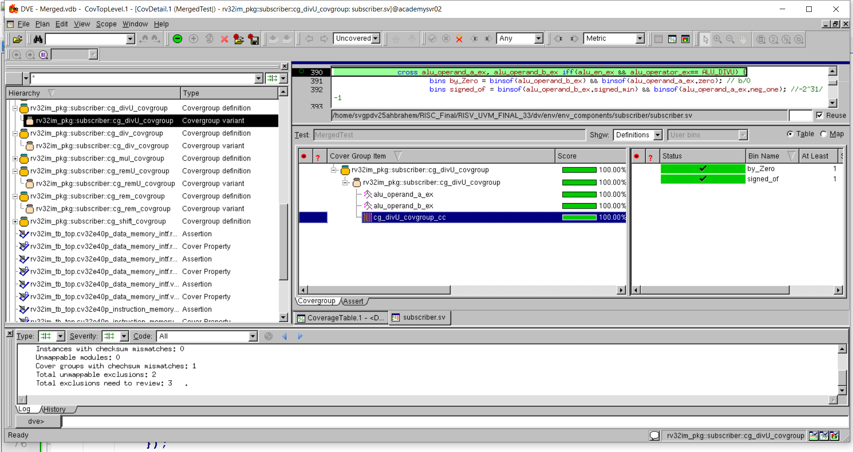
Coverage Closure

Slide 63
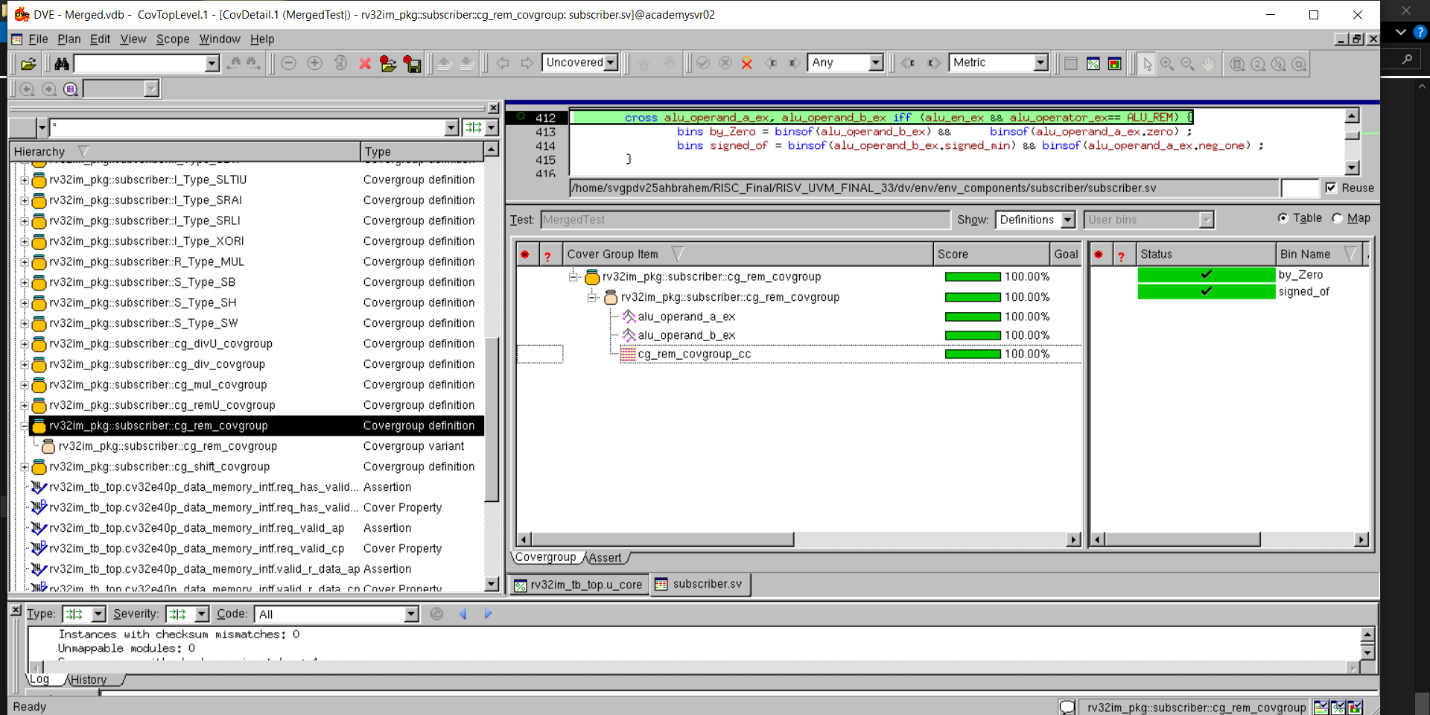
Coverage Closure

Slide 64
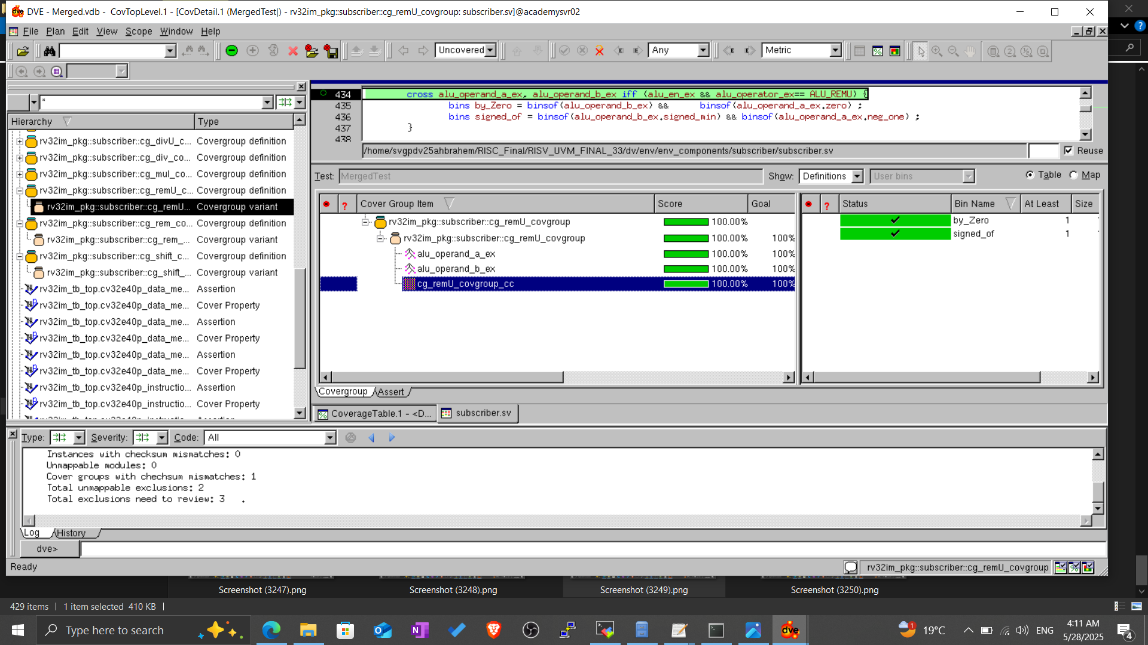
Coverage Closure

Slide 65
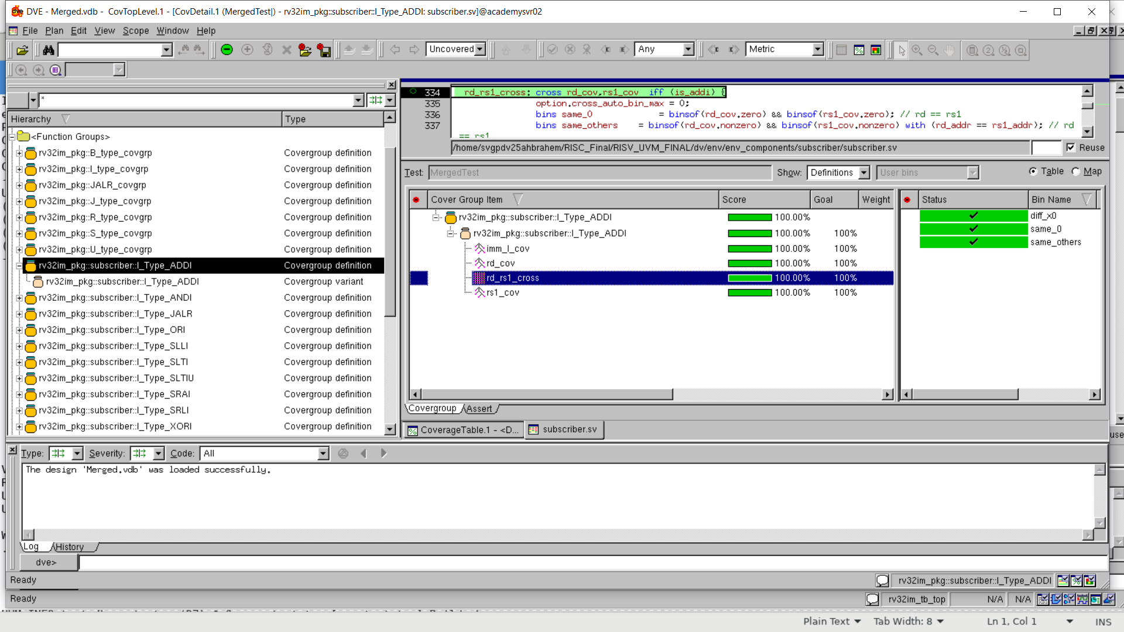
Coverage Closure

Slide 66
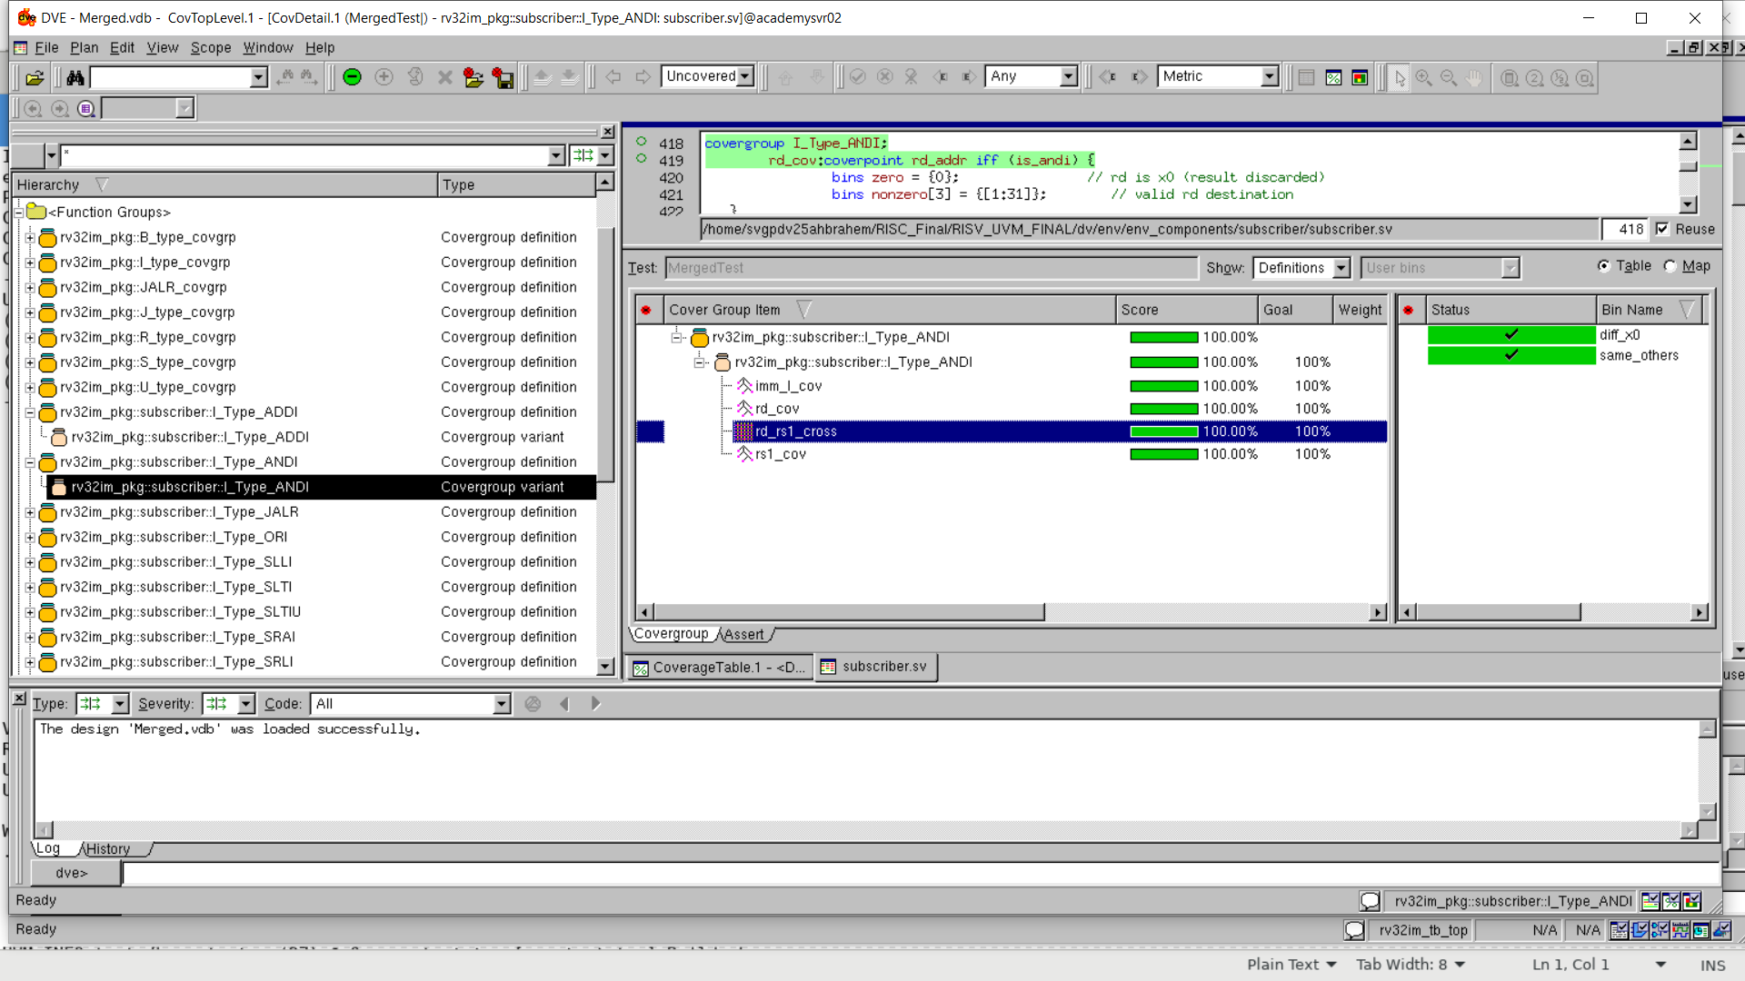
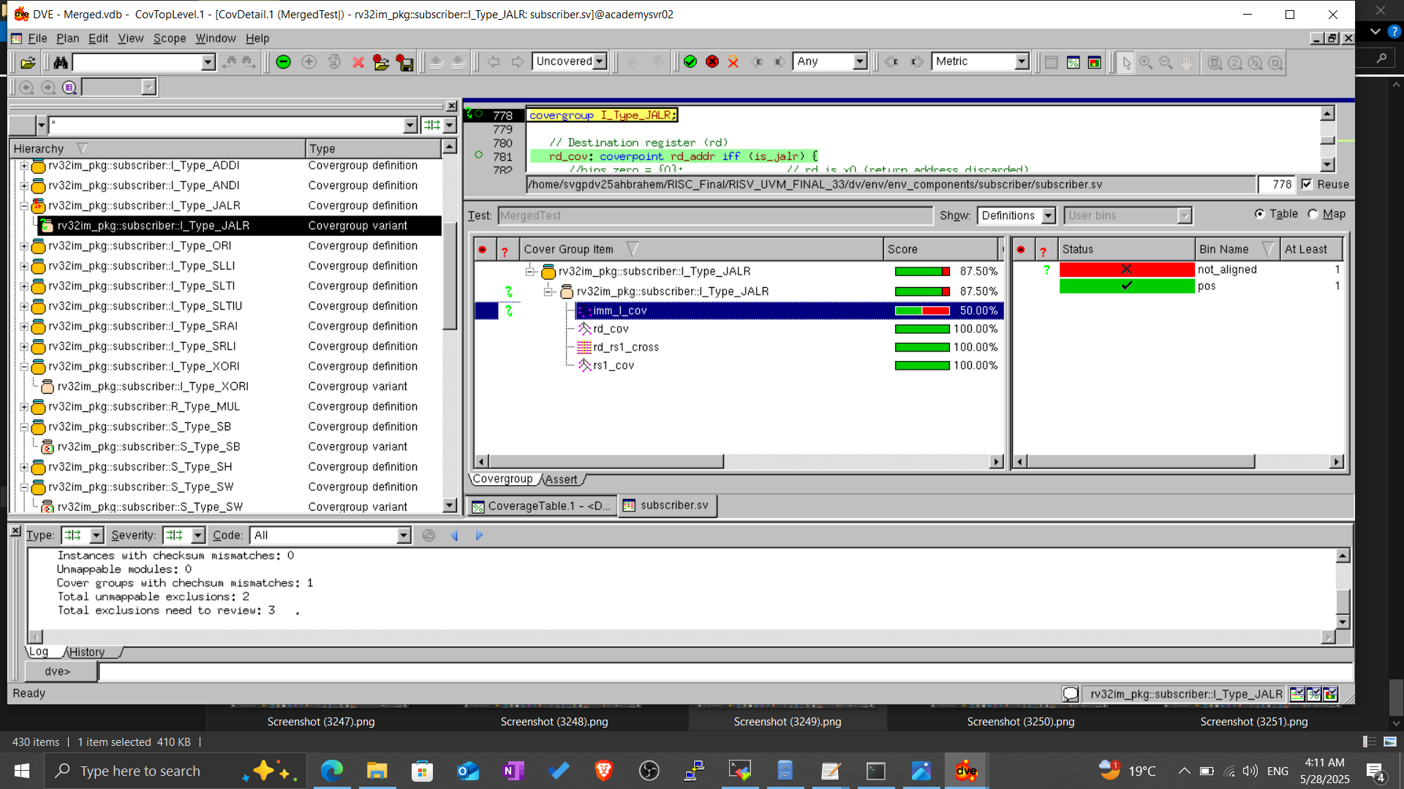
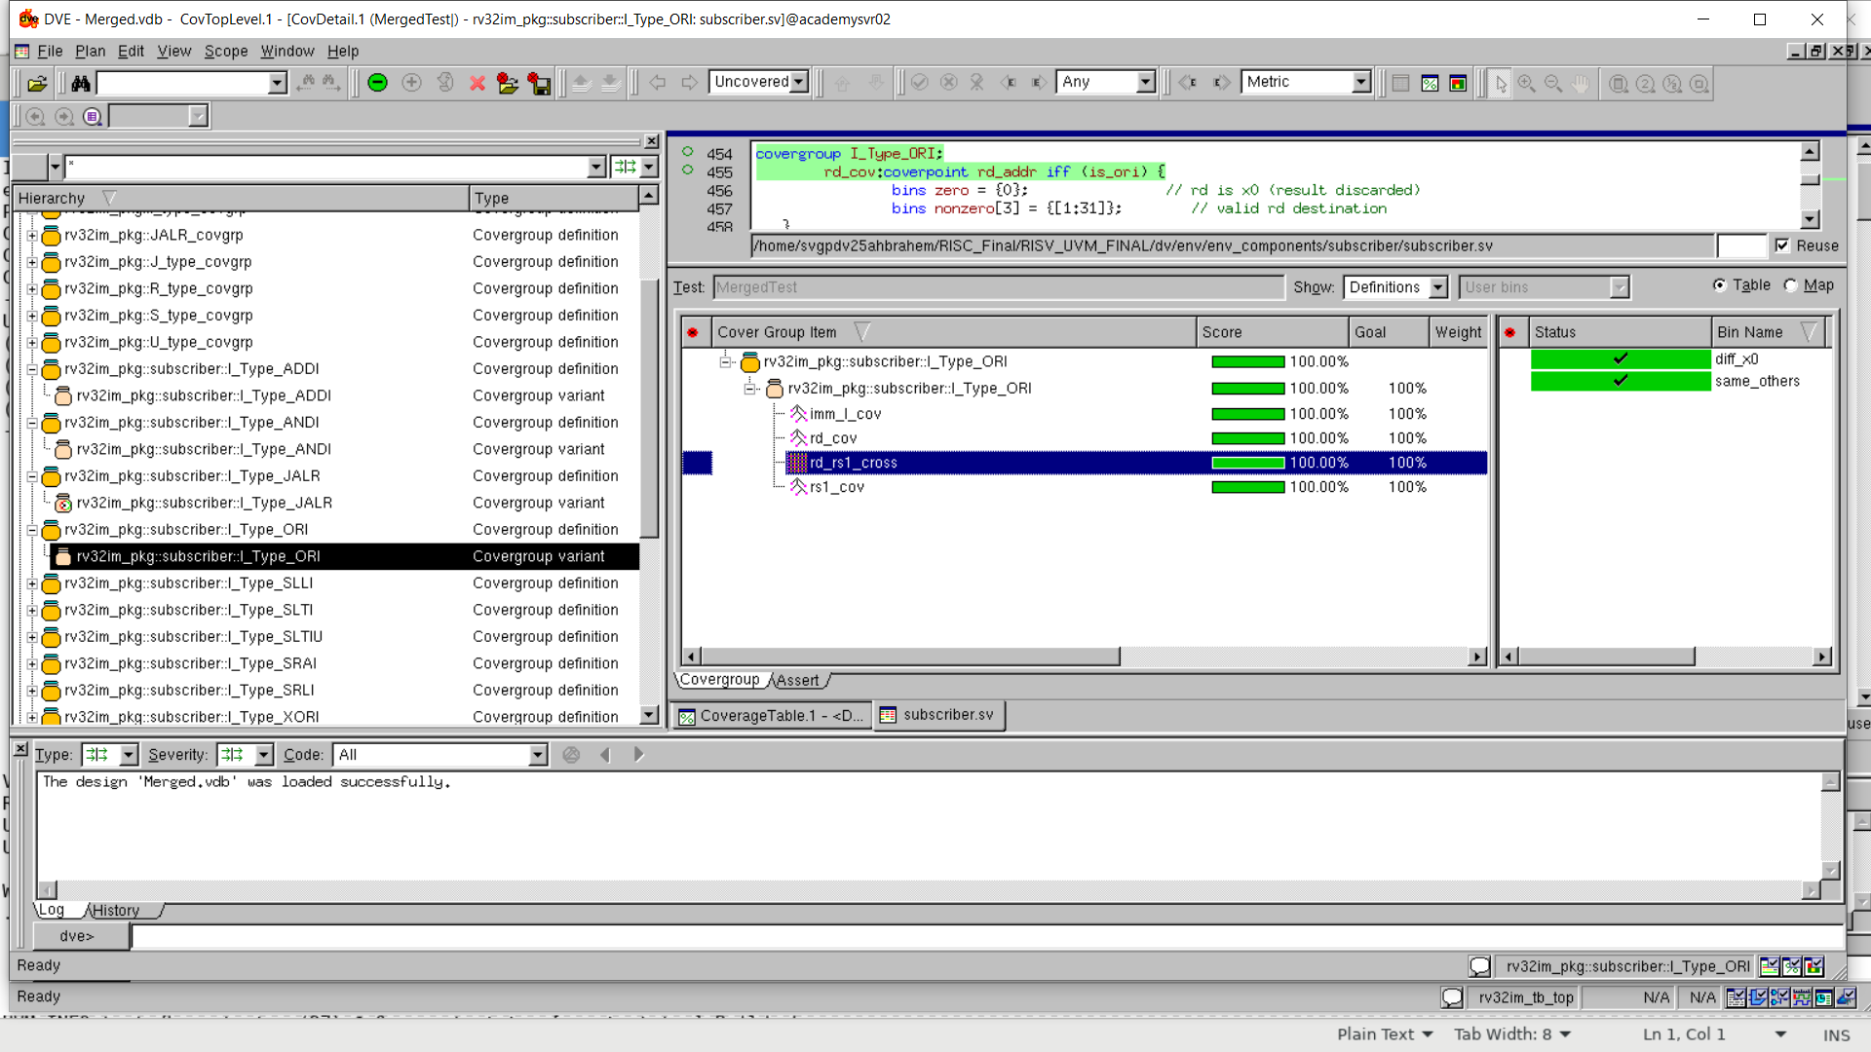
Coverage Closure

Slide 67
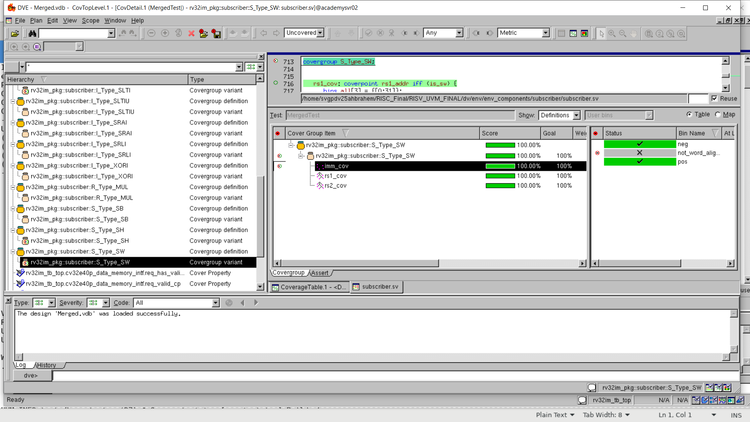
Coverage Closure

Slide 68
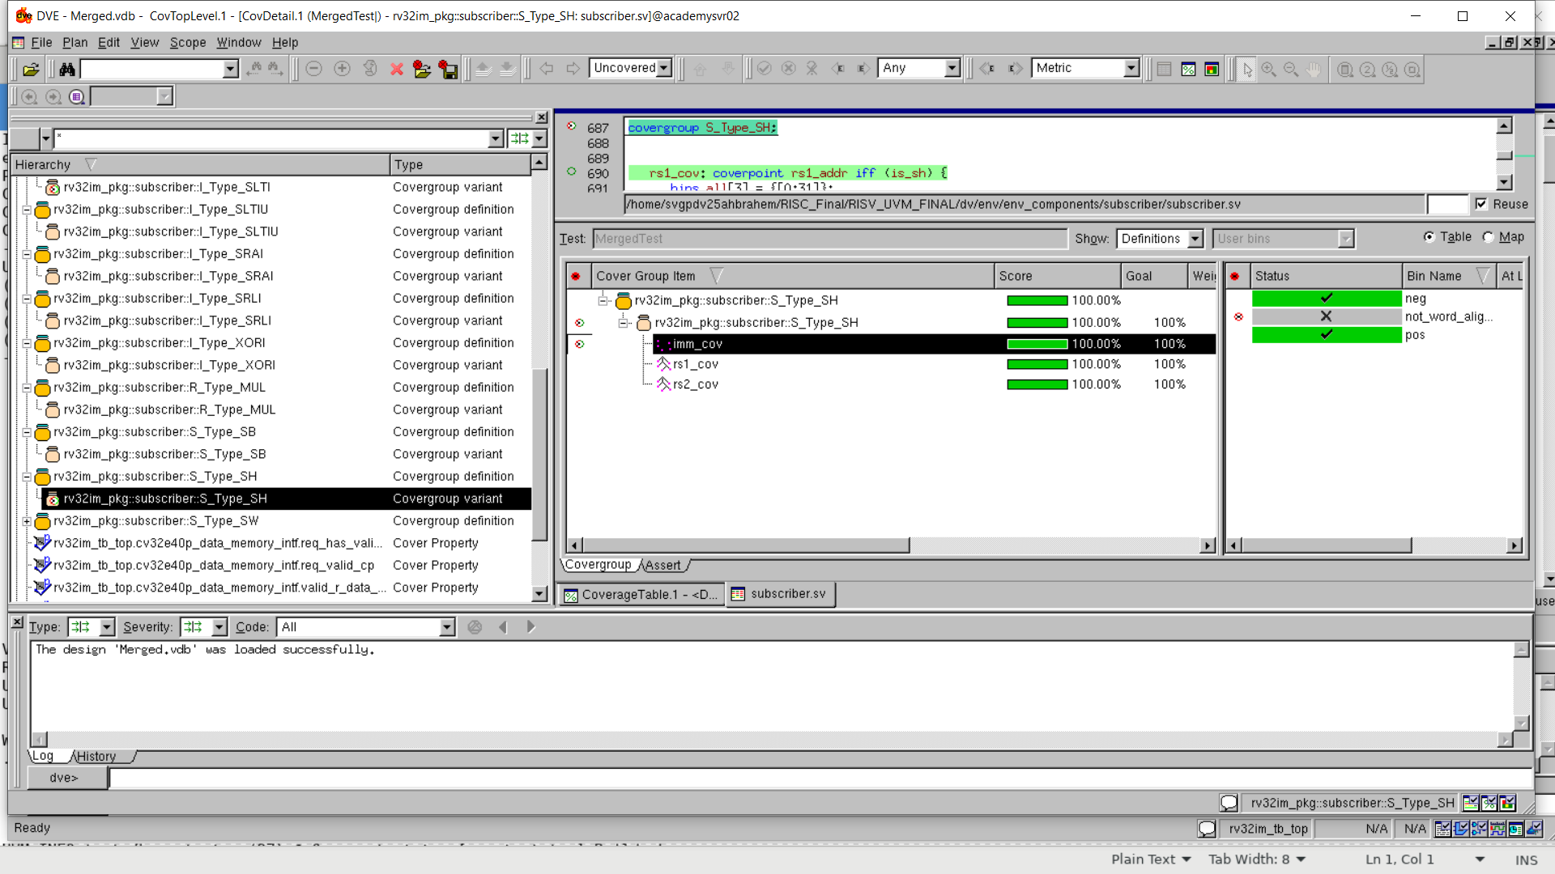
Coverage Closure

Slide 69
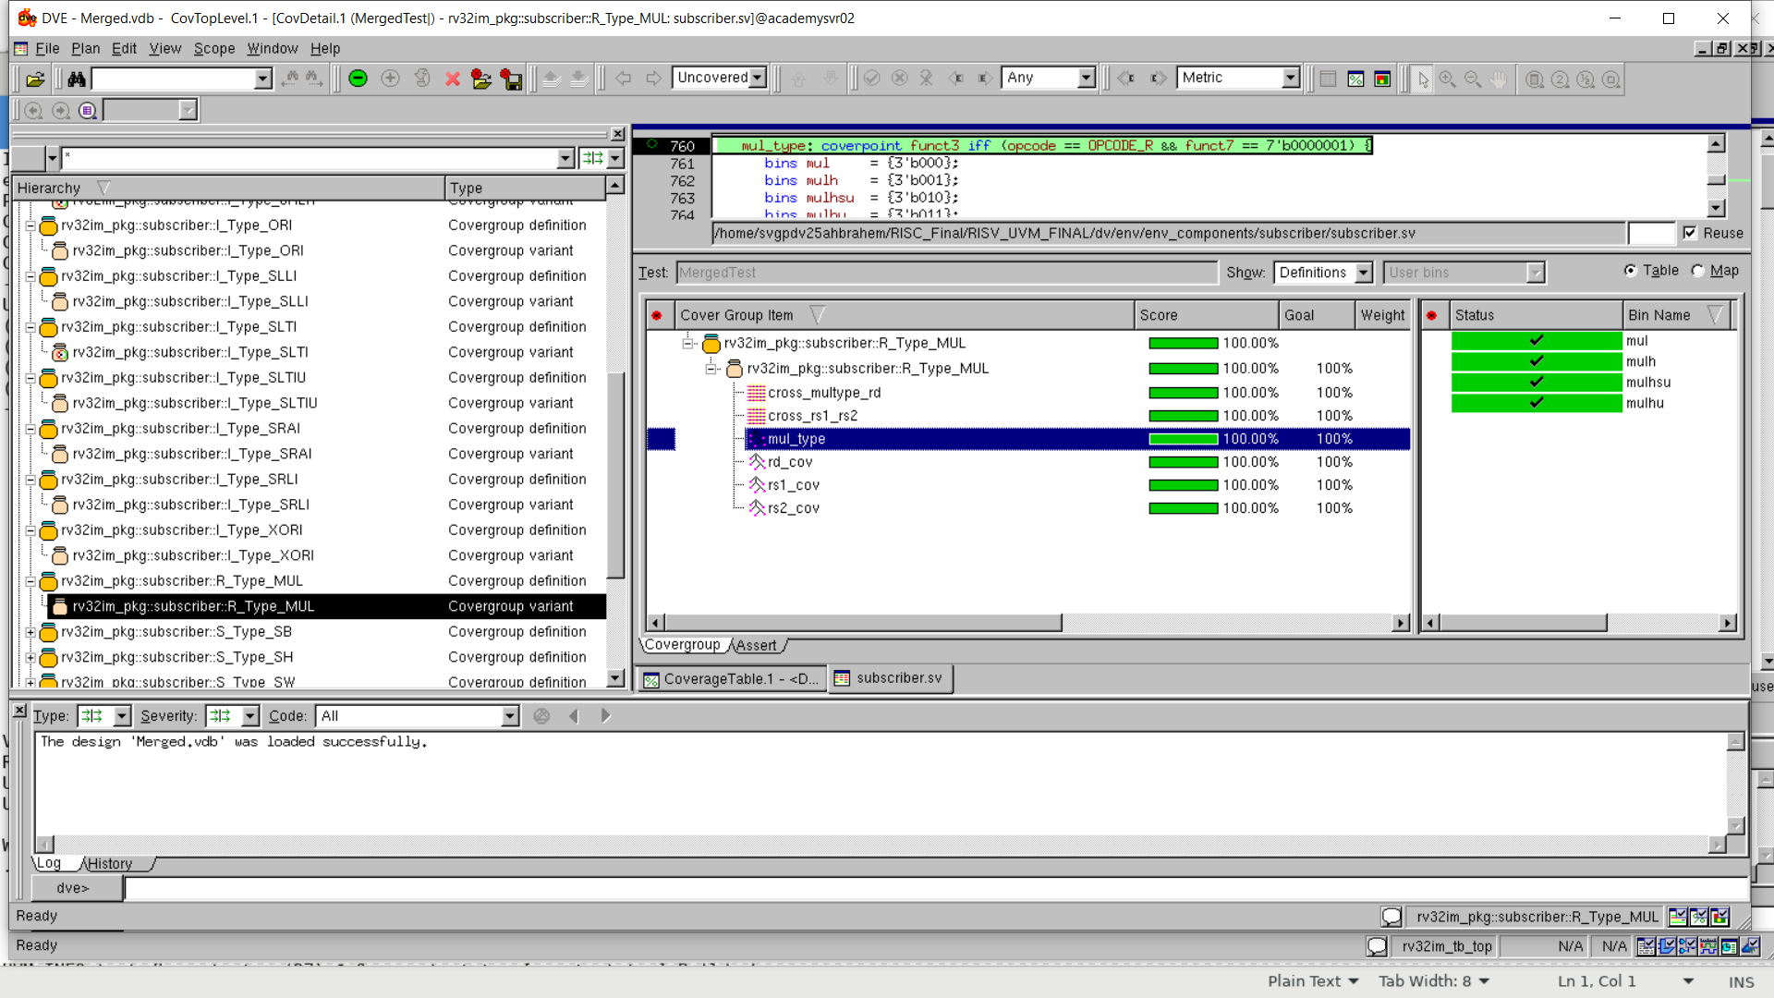
Coverage Closure

Slide 70
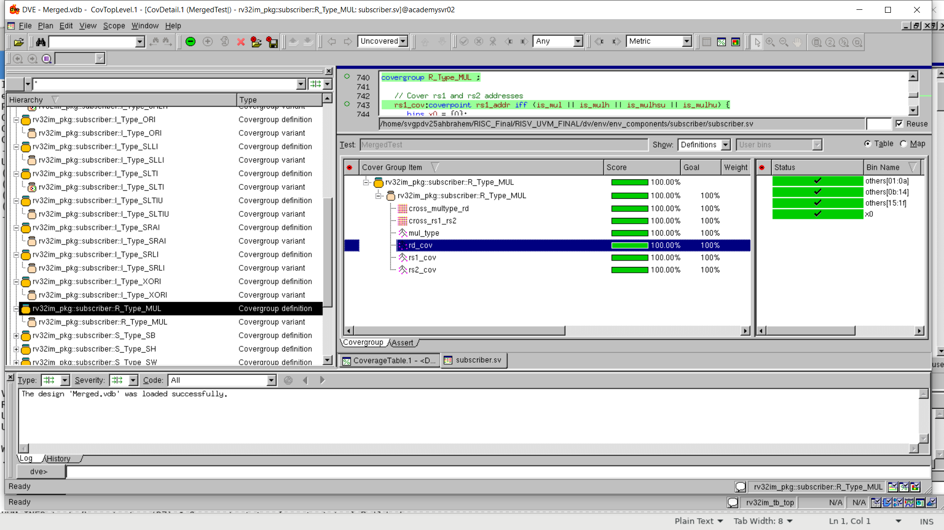
Coverage Closure

Slide 71
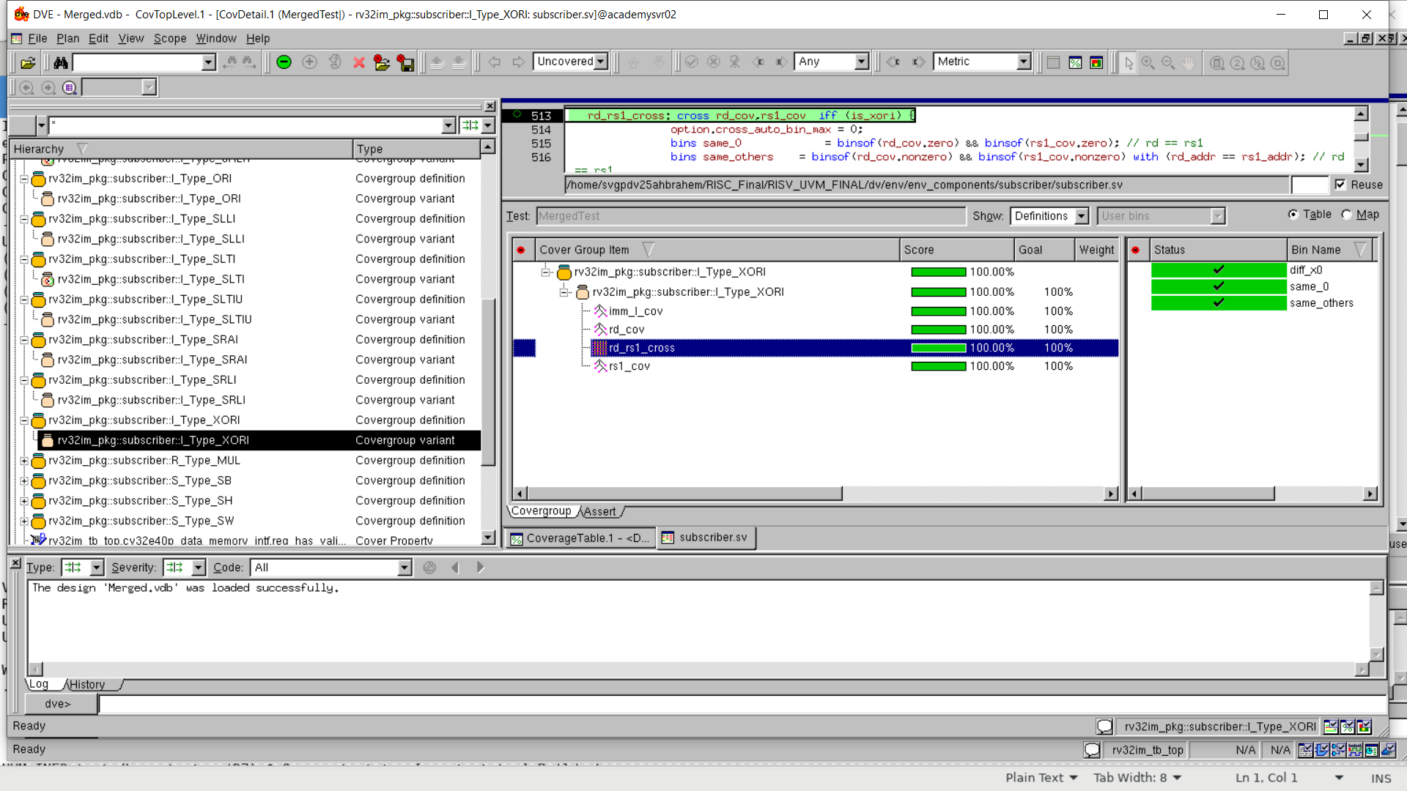
Coverage Closure

Slide 72

Coverage Closure

Slide 73

Coverage Closure

Slide 74

CODE COVERAGE

Slide 75

CODE COVERAGE

Slide 76

CODE COVERAGE

Slide 77

Assertions

Slide 78

Assertions

Slide 79

Assertions

Slide 80

Assertions
The above failures are due to the DUT continuously driving instr_req_o even though the instr_gnt_i has been off for a long time.

Slide 81

Verbosity

Slide 82



Different Verbosity for Different Debugging Needs
UVM_LOW for Reporting & Checking that the hierarchy is starting correctly & Scoreboard Mismatches
UVM_HIGH for deep-level & case Debugging (usually during the development phase)
UVM_MEDIUM for Correct Cases tracing & Expected behaviour

Slide 83
Project Path
/home/svgpdv25ahbrahem/RISC_Final/RISV_UVM_FINAL/dv/
Command: ./run.sh

Slide 84
Conclusions & Future work
Achieved 99% FC but low code coverage as the dut Includes various set of instructions that have not yet been tested (we only test RV32IM)
Add more test scenarios to hit illegal instructions & more corners of DUT & increase code coverage

Slide 85
Thank You

Slide 86

Thank You

Slide 87


Slide 88

Thank You

Slide 89

Thank You

Slide 90

Thank You

